Slide 1
Wirtinger Presentations
And Virtual Knots

Slide 2
Wirtinger Presentation
<t1, … tp| r1, … rq>
generators relations
Relations in the form rk: ti = (wk)(tj)(wk^-1) for some word wk
For example: t1 = (t2t3)(t4)([t3^-1][t2^-1])
All generators are conjugate

Slide 3
Cyclic and Realizable presentations
Cyclic:
It is Wirtinger
<t1, … tn| r1, … rn> same number of gen and rel
ri: t[i+1] = (wk)(ti)(wk^-1) only adjacent generators now
Realizable:
It is Cyclic
wk - one letter words only (tk or tk^-1)

Slide 4
Goal: Wirtinger of 0 or 1 deficiency -> virtual knot
Steps:
Wirtinger of 0 or 1 deficiency -> Cyclic
Cyclic -> Realizable
Realizable -> Gauss Diagram
Gauss Diagram -> Virtual knot (we’ve seen already)

Slide 5
Cyclic -> Realizable
Step by step break down ‘bad’ relators
r1: t2 = (t3t7^-1t5)t1(t5^-1t7t3^-1)
Introduce two more generators, three more relations, omit r1
t1’ = t5t1t5^-1
t2’ = t7^-1t1’t7
t2 = t3t2’t3^-1
Still Cyclic, but 1 less bad relation

Slide 6
Wirtinger (0,1) -> Cyclic
If deficiency is 1, double one of the relations. So assume def is 0. Represent as a graph. Create a vertex for each generator, edge between vertices iff corresponding generators are related. Graph is connected since all the generators are conjugate (by definition of Wirtinger).
Operation that we require: in any triangle, picking any two edges from it gives same result. In group terms that is, conjugation relation is transitive.
So having edges (i,j), (j,k) we can throw any one of them and add (i,k).

Slide 7
Wirtinger (0,1) -> Cyclic (cont)
Because our graph has more edges than maximal tree does, it has a cycle C. Assume its length is < n. We need to obtain a cycle of length n. Induction on length of C. Say some vertex vi is not in C. There is a path from vi to vertex in C, say some vk, since graph is connected. On that path there is first vertex which is not in C call it vj. We have and edge (j,k) and 2 edges from vk to vertices in C, so by performing the described above operation we can add vj to the cycle C. Its length will grow by 1 and we can do this as long as there are vertices not in C, which completes the argument.

Slide 8
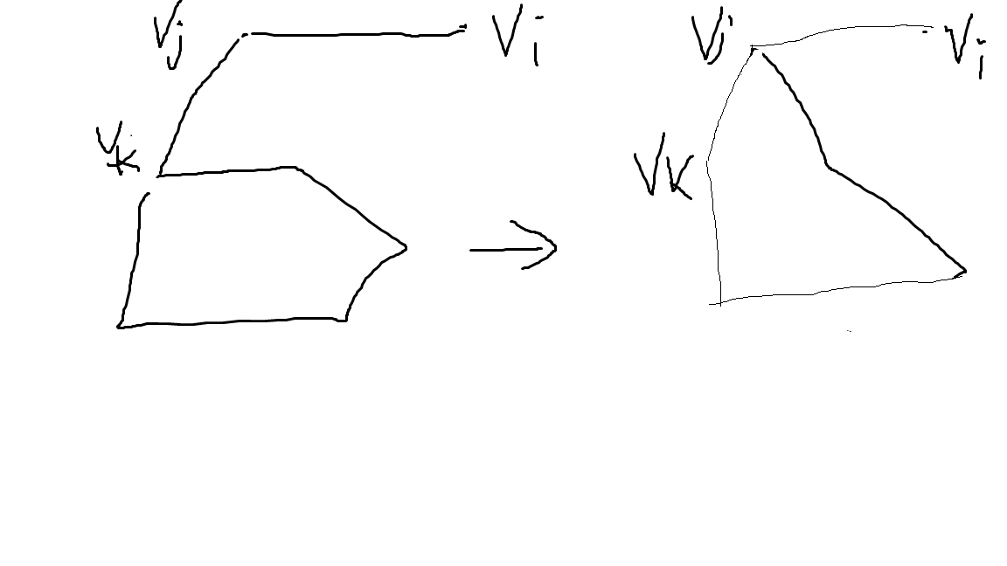
Illustration of the algorithm

Slide 9
Realizable -> Gauss Diagram
Start with a circle. Split it into n arcs. Assign consecutive generators to consecutive arcs. For a relation between consecutive generators (and those are the only ones we have) draw an arrow to the point splitting corresponding arcs from the arc corresponding to generator which we are conjugating by (that is why we need the one letter word condition). Assign a sign to an arrow accordingly.

Slide 10
References
Se-Goo Kim “Virtual Knot Groups”
https://arxiv.org/abs/math/9907172

